Slide 1

人工智慧理論與應用 Artificial Intelligence Theory and Application
Instructor: 馬豪尚/張家瑋/洪啟舜

Slide 2
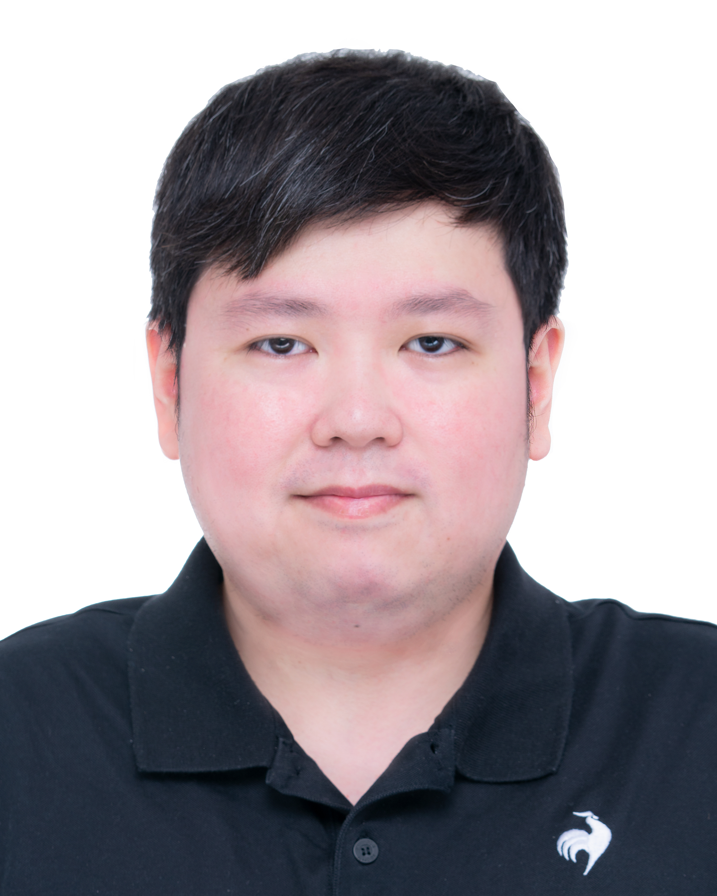
Instructor
馬豪尚 (Hao-Shang Ma)
Office: 2505/2504
Office Hours: 週二14:00~17:00 週四14:00~17:00
Email: hsma@nutc.edu.tw

Slide 3
Research Area
資料探勘 (Data Mining) / 機器學習(Machine Learning)
/ 人工智慧 (Artificial Intelligence)
社群網路分析(Social Network Analysis)
推薦系統(Recommender Systems)
大數據資料分析(Big Data Analysis)

Slide 4
Course Syllabus
Introduction to Artificial Intelligence
Data Mining
Machine Learning
Deep Learning
Neural Network Basis
ANN
Computer Vision
CNN
Natural Language Processing
RNN/LSTM/Transformer

Slide 5
Course Syllabus
Unsupervised Learning
Auto-Encoder
Generative AI
Generative Adversarial Network
Self-supervised Learning
Reinforcement Learning

Slide 6
Data Mining
Pattern Mining
Classification
Clustering

Slide 7
Machine Learning
Supervise Learning
Classification problems
Unsupervised Learning
Clustering problems
Text mining
Semi-supervised learning
The classification problem with some missing labels
The clustering problem with some labels
Reinforcement Learning

Slide 8
Deep Learning
Neural Network Basis
Artificial Neural Network(ANN)
Convolutional NN
Residual NN
Auto-Encoder
Generative Adversarial Network
…

Slide 9
評量方式
期中報告
對於期中之前上課的內容交一份報告和心得
可寫中文/英文
論文研討
選擇一篇列表上的論文進行簡報報告
繳交簡報投影片

Slide 10
Teams團隊
團隊代碼
zj8mhqc

Slide 11
Paper List of Presentation
https://docs.google.com/spreadsheets/d/1m77-XwwEeFg8-GMIU1VW_Vgf0wfq6Hzb51E-Z8mSaGQ/edit#gid=0

